Slide 1
Temp State OU Analysis
Analysis by:
Quentin Odongo, Salim Faraj & Theodore Kamau

Slide 2
Issue Definition
What We Know
In-house Issue Reproduction
Analysis
Next Steps

Slide 3
Issue Definition
A number of the KP tank temperature sensors are sending OU alerts while at the same time the ethanol sensor reading momentarily drops to 0. This causes failure on the temp sensors which end up needing to be hard/soft reset or replaced (NOC PRB 60).
So far 12 cases have been reported as logged in this google sheet.
Scope of the project: To find the root cause of the failure, to investigate the relation between the 2 sensors suddenly dropping to zero at the same time, find a solution/recommendation for an improvement in design/change in sensor.

Slide 4
What We Know
Data collected on the 12 KPs showed 2 common behaviours at the time of incident:
Firmware verification failure - 4 KPs.
Missing modem data in heartbeat - 8 KPs.
3 KPs were selected for further investigations: KP-0005, KP-0566, KP-0800.
KP Serial | Date/Time of OU Occurrence
KP-0005 | 24th Jan 2020 (Twice: 3:43 p.m. and 3:45 p.m.)
KP-0566 | 16th (1:23 p.m.) and 24th (2:16 p.m.) Jan 2020.
KP-0800 | 16th (6:04 p.m.) and 23rd (2:40 p.m.)

Slide 5
What We Know
Incident occurred after a KP restart in all 3 cases
Restart seems to affect both the ethanol and temperature sensors, either at the same time or at different times
Out of the 3 KPs, 2 had firmware verification errors at the time of the incident
Modem data on database missing most of the time for all 3 KPs

Slide 6
Reproducing the Issue In House
Test Setup & Procedure
One prod-int KP for maintenance used for the test
KP set up to be restarted several times a day for the duration of the test (1 week)
Data pulled from prod-int database for analysis (Ethanol sensor, temperature sensor and heartbeat data)

Slide 7
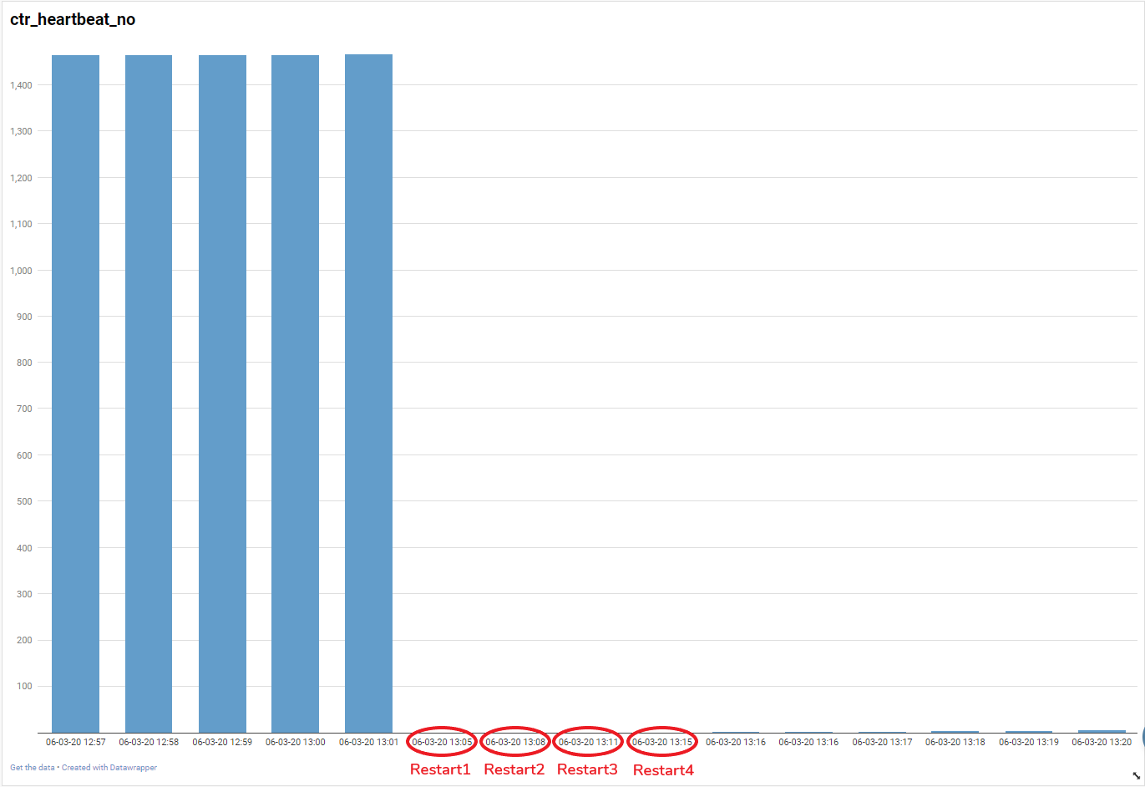
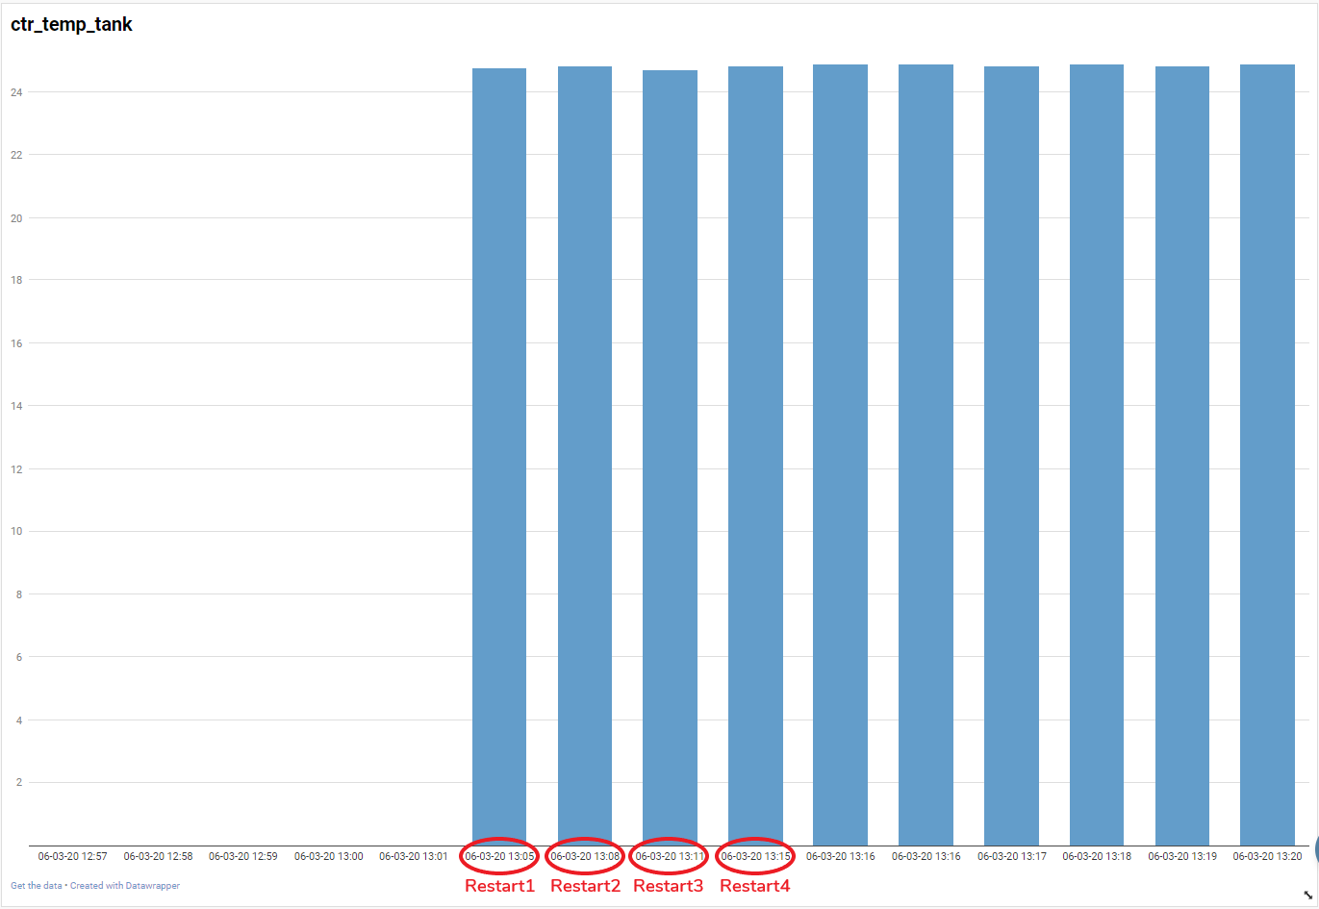
Results: Day 1 (06/03/2020)
Heartbeat Data vs Temp Sensor Data:

Slide 8
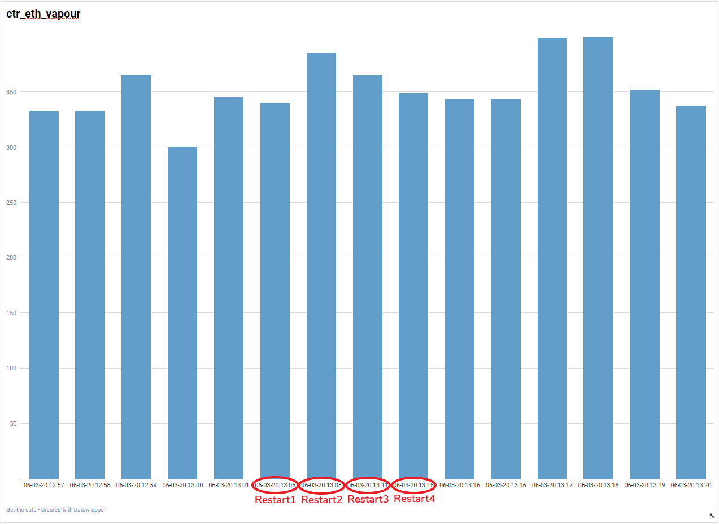
Results: Day 1 Cont’d
Ethanol Sensor Data:

Slide 9
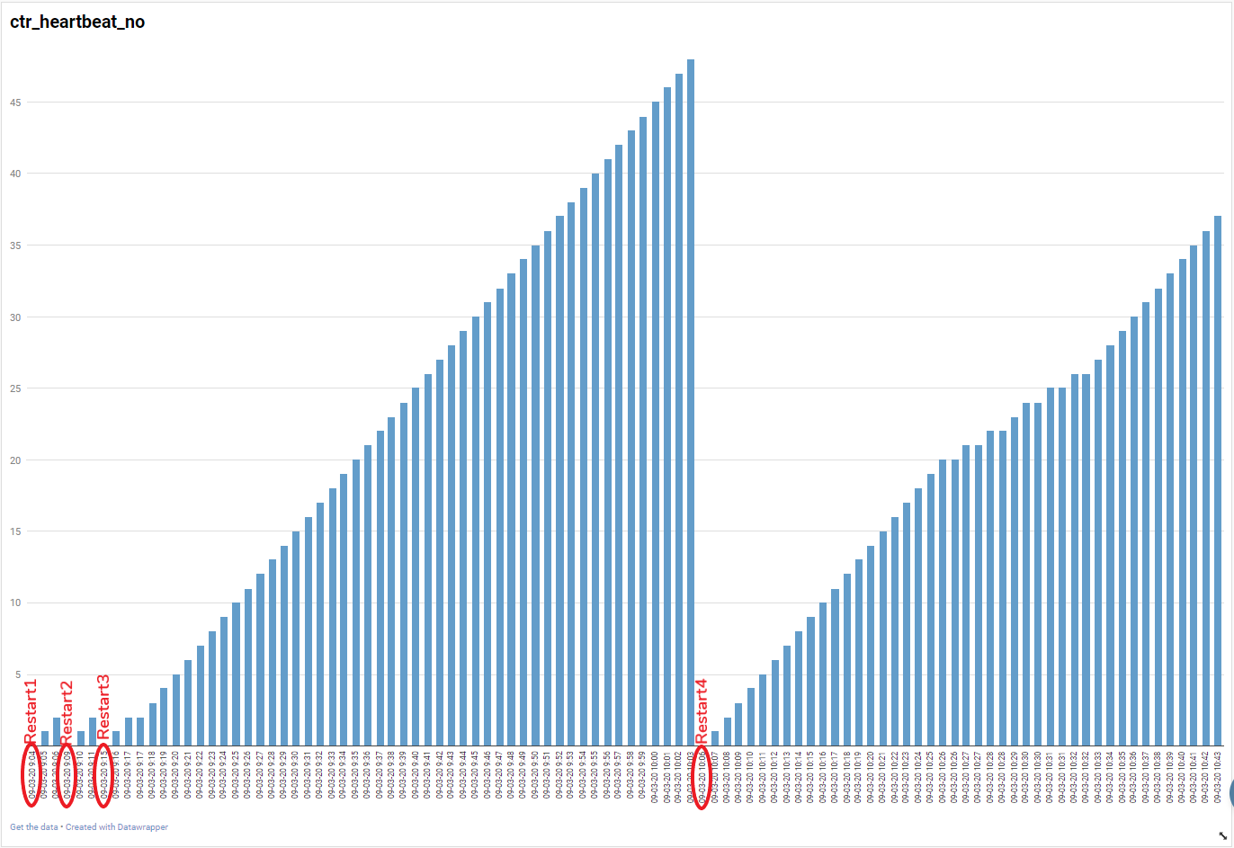
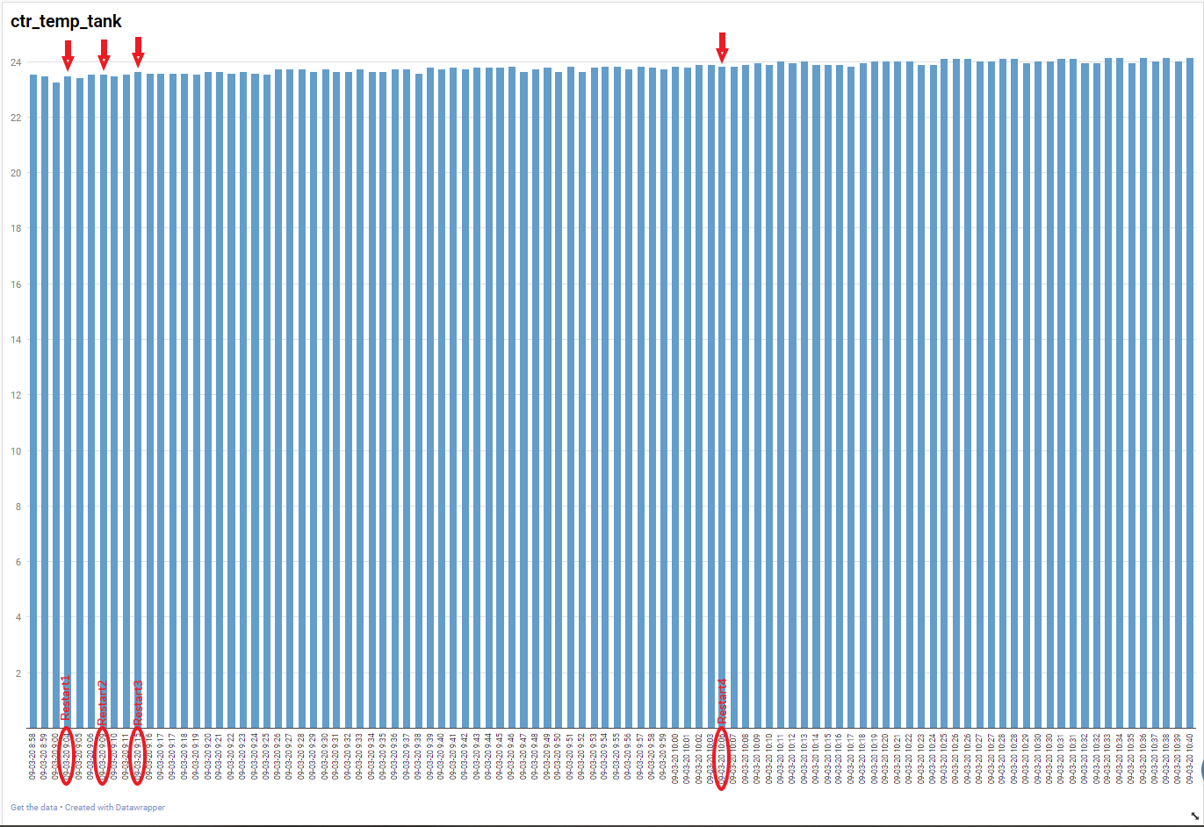
Results: Day 2 (09/03/2020)
Heartbeat Data vs Temp Sensor Data:

Slide 10
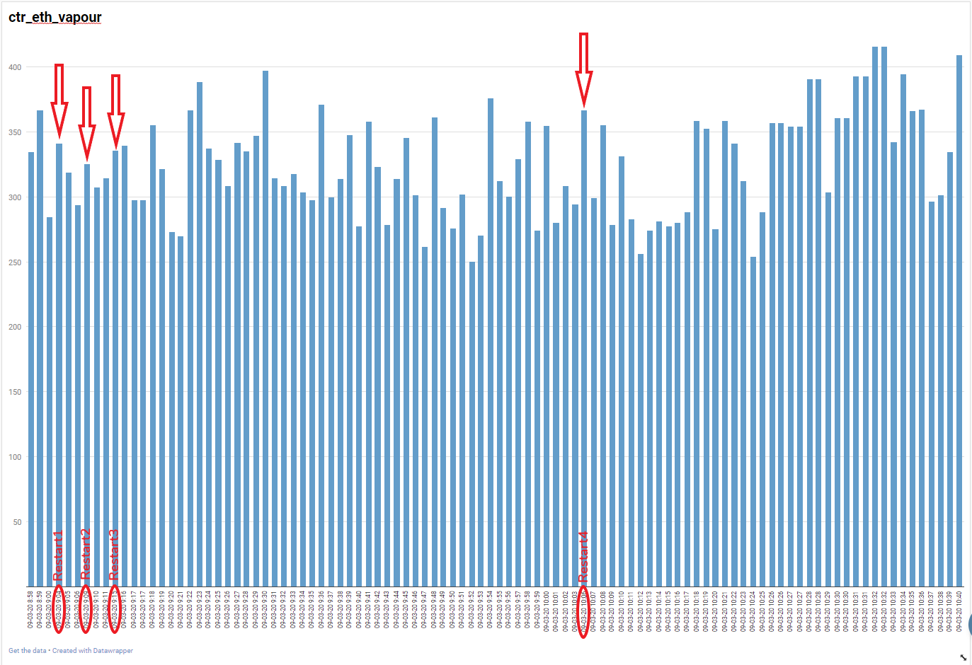
Results: Day 2 Cont’d
Ethanol Sensor Data:

Slide 11
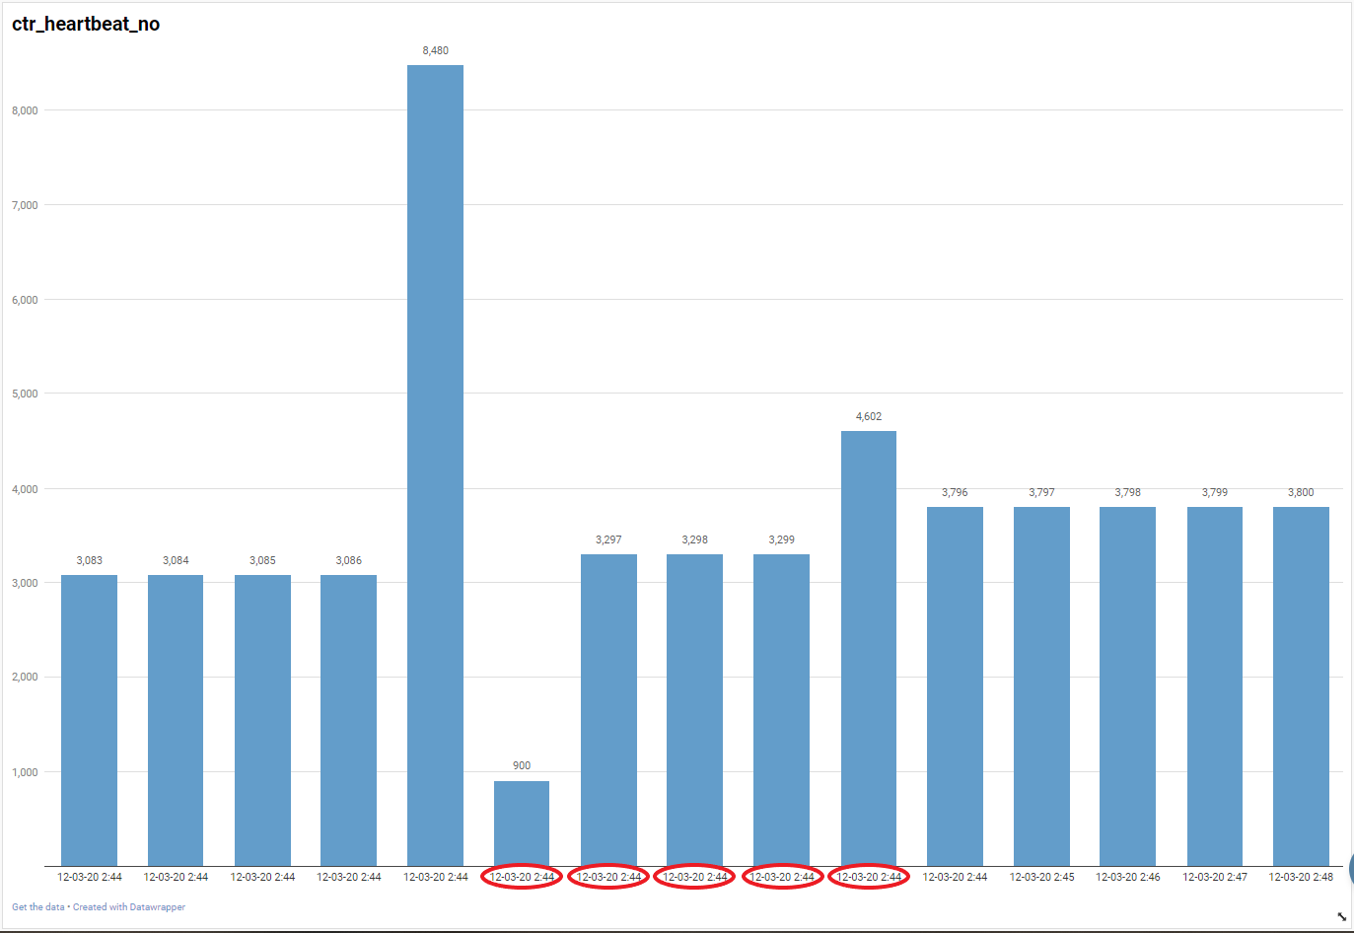
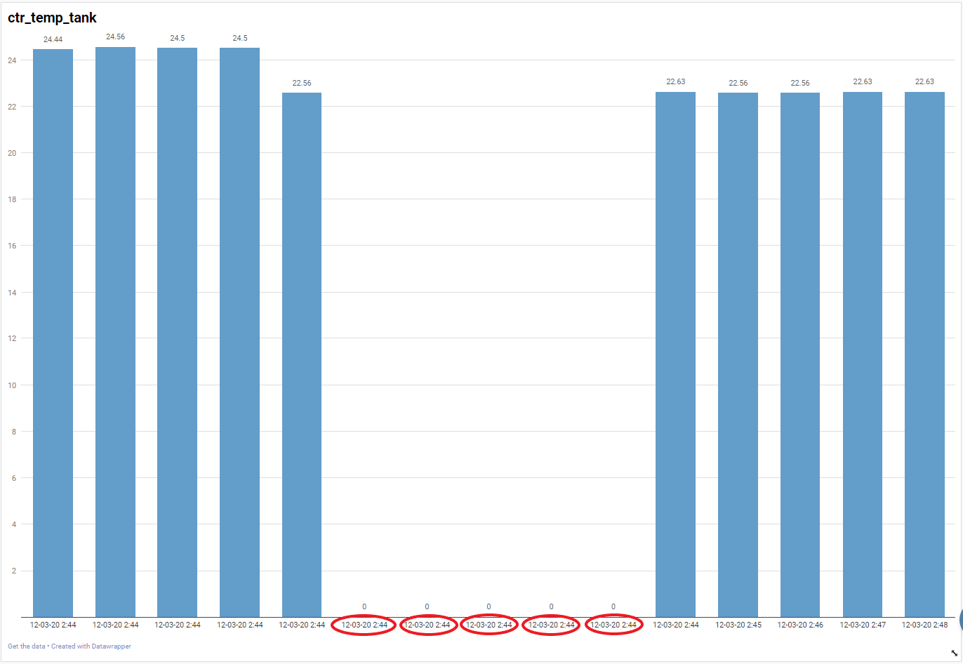
Results: Day 3 (12/03/2020)
Heartbeat Data vs Temp Sensor Data (no restarts done):

Slide 12
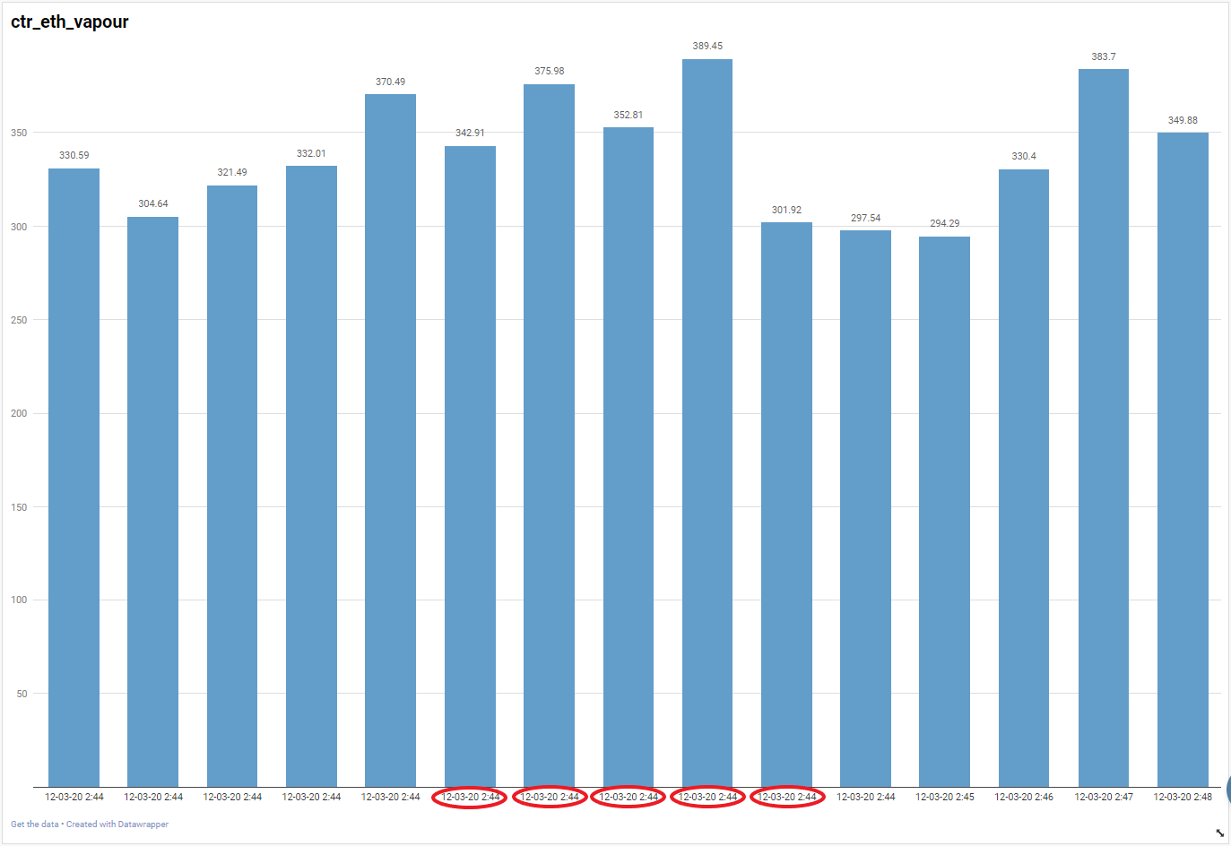
Results: Day 3 Cont’d
Ethanol Sensor Data (no restarts done):

Slide 13
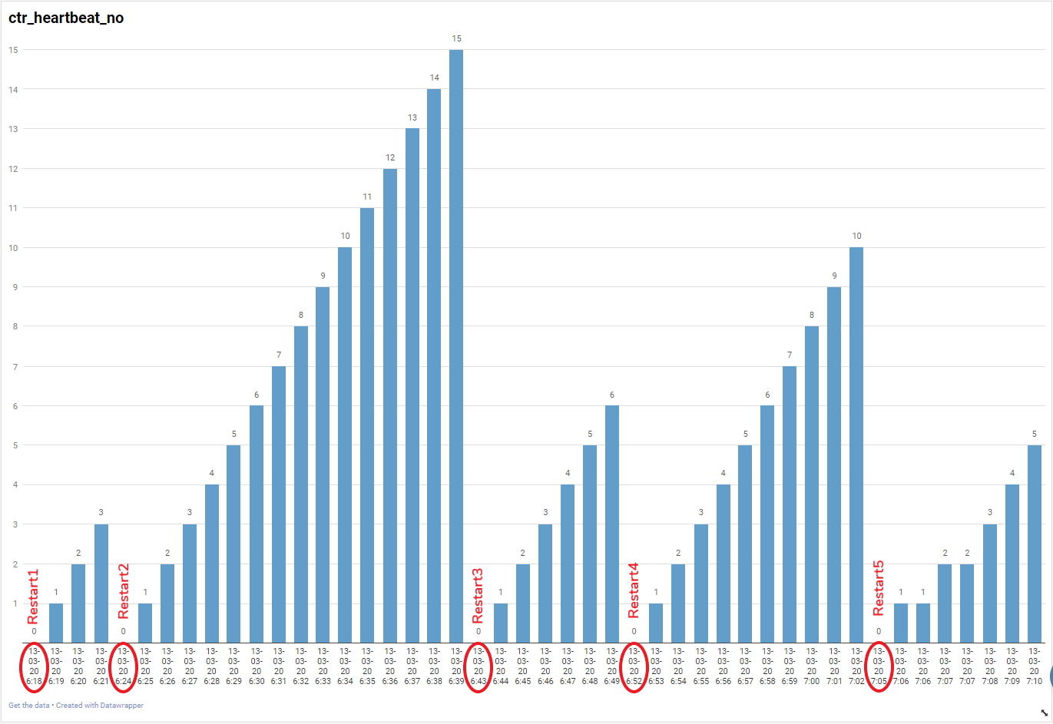
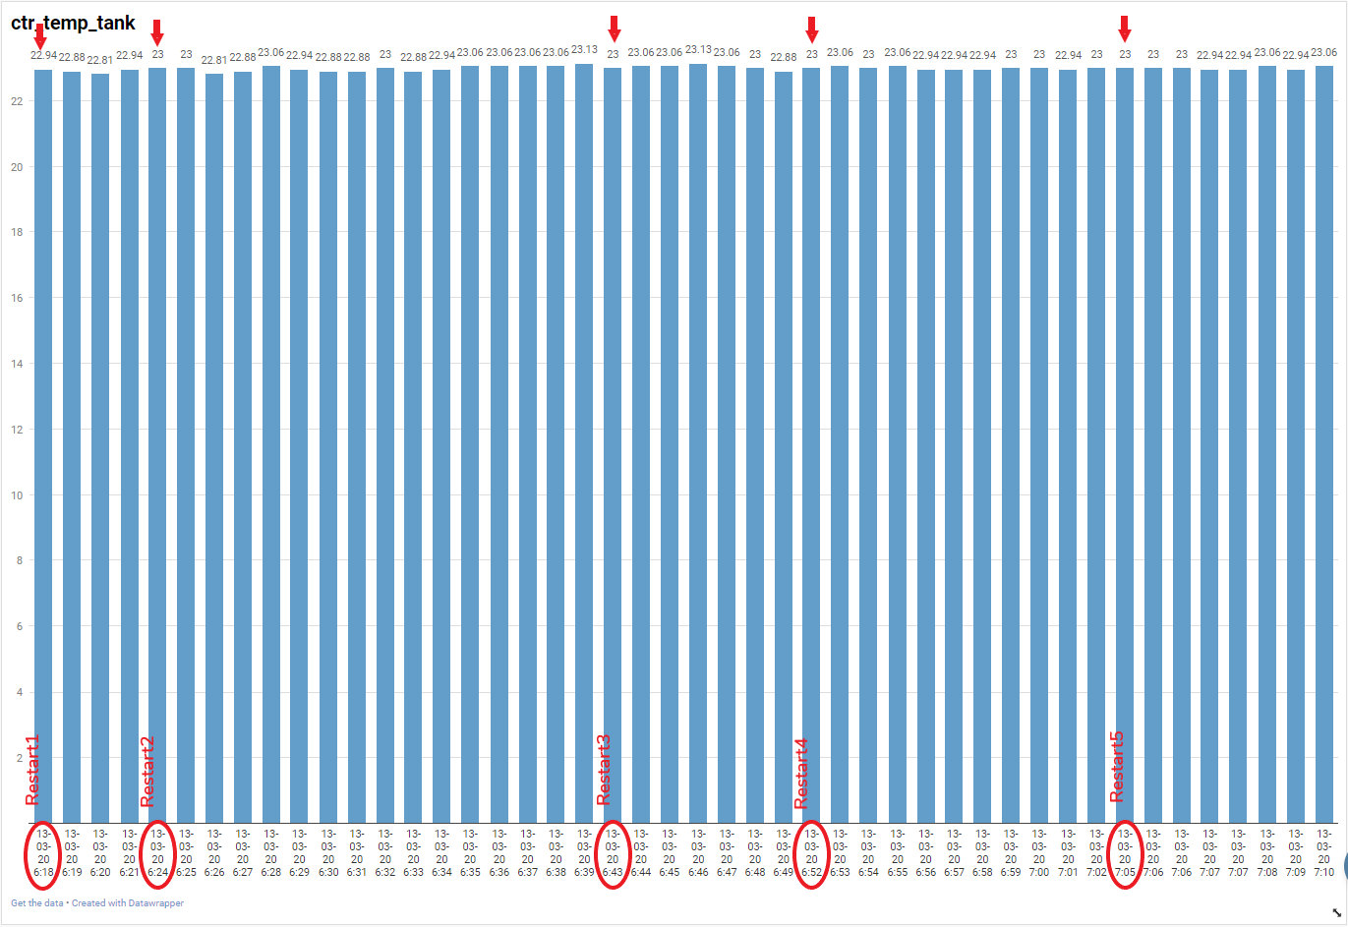
Results: Day 4 (13/03/2020)
Heartbeat Data vs Temp Sensor Data:

Slide 14
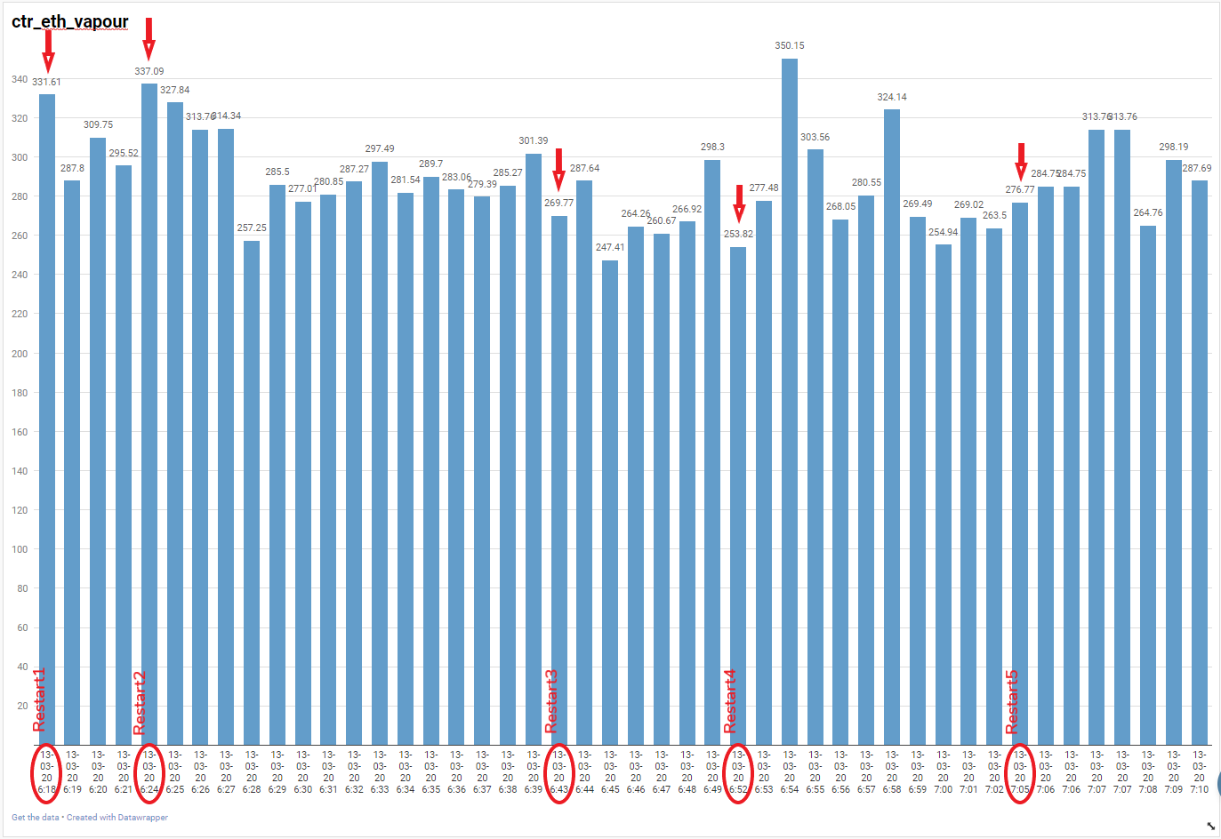
Results: Day 4 Cont’d
Ethanol Sensor Data:

Slide 15
Summary of In House Test
Ethanol sensor issue was not reproduced during the test. It showed minimal reaction (on few occasions) to the restarts done. Consequently, I propose this to be treated as a separate issue from the Temp Sensor Issue
Temperature sensor only reacted to the restarts twice during the test duration
Further investigation required to find root cause

Slide 16

Analysis
Identify and analyze possible root causes
Identify solution

Slide 17
Identify and Analyze Possible Root Causes
5 Why Analysis for Temp Sensor/Ethanol Sensor Issue
The following possible root causes were identified from the 5 why analysis:
Shortcomings in the KPC firmware (Most likely)
Signal integrity of the temp sensor could be compromised (Likely)
Same power & ground lines shared by temp sensor & ethanol sensor; restart could be causing issue due to this (Unlikely)
Bug in firmware code (Unlikely)
Natural aging of the sensor (Unlikely)
Adjacent components could be affecting temp sensor (Unlikely)

Slide 18
Identify Possible Solution(s)
Check for KPC firmware loopholes
Inspect signal integrity & quality of temperature sensors

Slide 19
Check for KPC F/W Loopholes/Shortcomings
Upon investigation, it was discovered that the current KPC firmware does not regularly check whether it is receiving a signal from the temperature sensor. It only does so during a restart
Modifications were thus made to the KPC firmware first to check or initialise the devices connected to the board before taking the temperature readings
Tests were done for further analysis on this issue, as described on the next slides:

Slide 20
Tests on 12 Sampled Sensors
Modified the KPC firmware to check the temperature sensors’ signals on every heartbeat, and bench tested it on 12 sample sensors, comparing the firmware readings with those of a Thermo Gun, and also the controller temp readings vs the sensor temp readings. The Infrared Thermometer was at 0.95 emissivity.
Comparing the readings from the controller/tank sensor and the thermo gun showed a variance that was not constant, thus rendering the thermo gun readings unreliable.
The only time a reading wasn’t recorded was when a specific sensor (KA8S0883) which was loose on the connector side would show that it was disconnected, when the cable was moved slightly. Other sensors recorded readings normally.
A comparison of the controller and tank temperature sensors readings showed that they were within the required specification, as shown on the next slide.
For more detailed information, refer to the following sheet: KPC vs Thermo Gun Readings Comparison

Slide 21
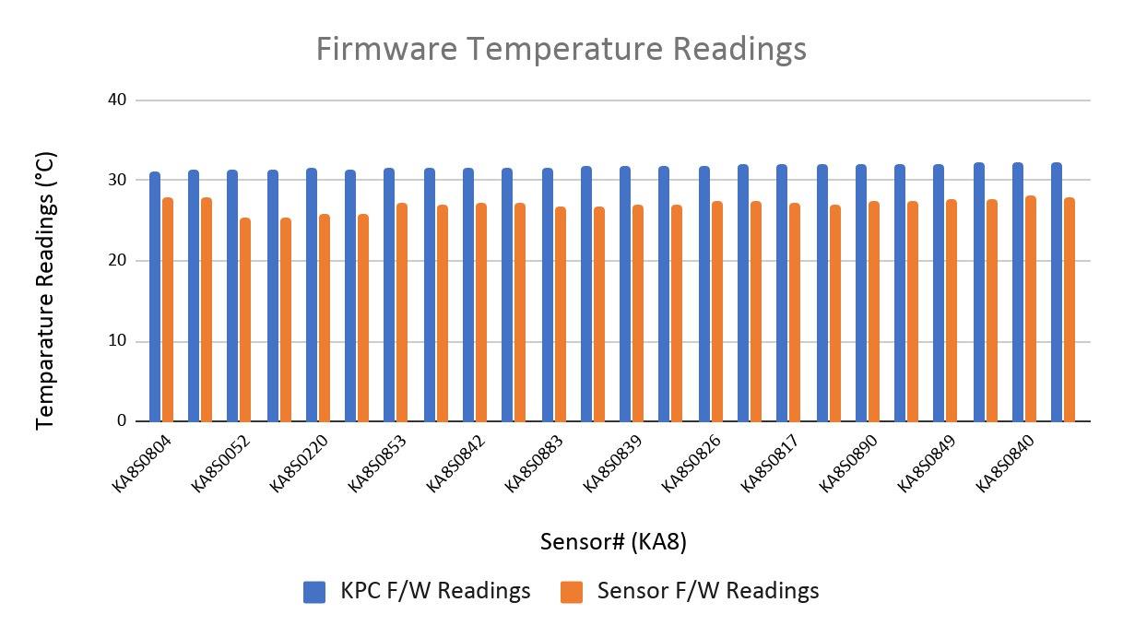
Results: 12 Sampled Sensors (Cont’d)

Slide 22
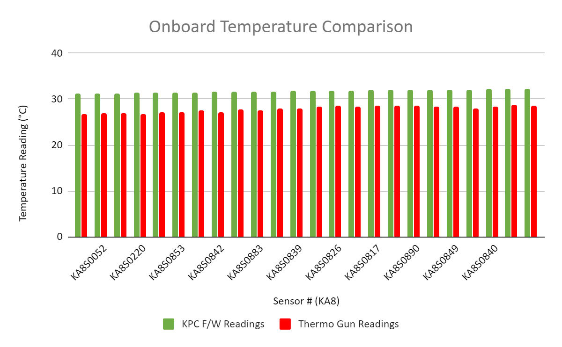
Results: 12 Sampled Sensors (Cont’d)

Slide 23
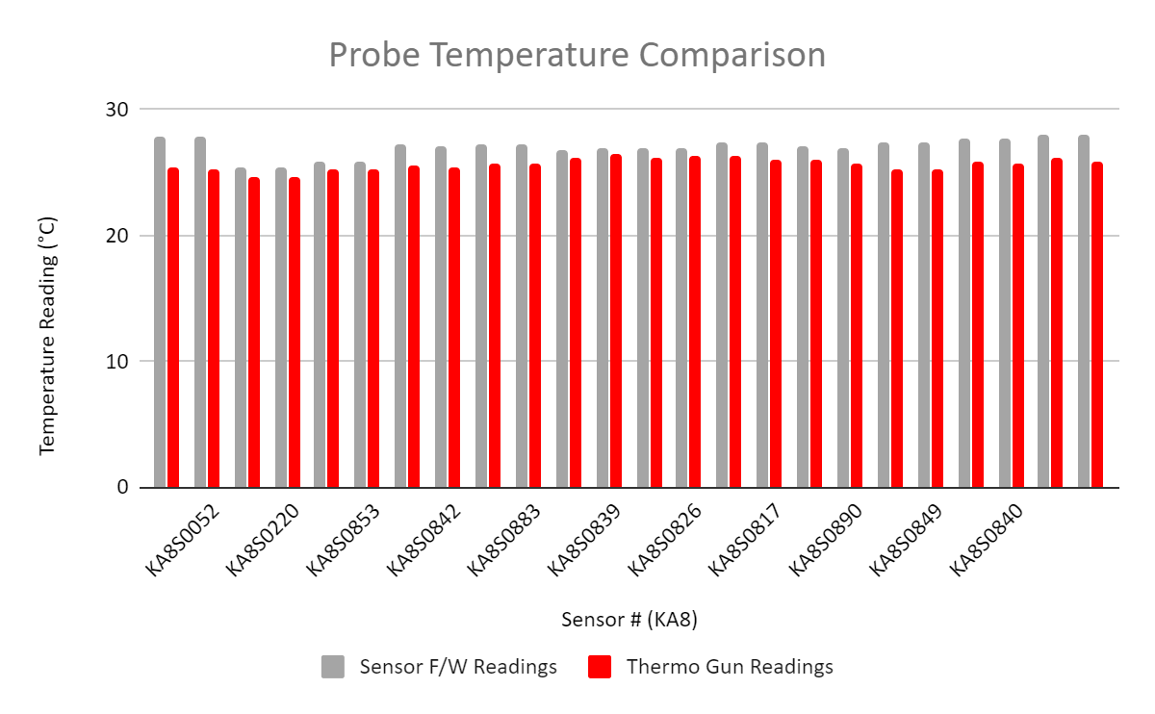
Results: 12 Sampled Sensors (Cont’d)

Slide 24
Testing Modified Firmware on Test KP
Modified the KPC firmware to check the temperature sensors’ signals every 20 minutes, while attempting to modify the sensors’ bit resolution, and tested it on the same prod-int KP used previously to do in-house tests, for 3 days. There was no dispense activity during the test.
Both the onboard and external temperature sensors recorded readings normally during the duration of the test.
Changing the resolution (accuracy) of the onboard sensor from 12 to 10 was successful, while for the tank temperature sensor changing from 9 to 10 was unsuccessful
The graph on the next slide shows a comparison of the onboard and external temperature readings during the duration of the test
For more detailed information, refer to the following sheet: Modified KPC F/W Readings

Slide 25
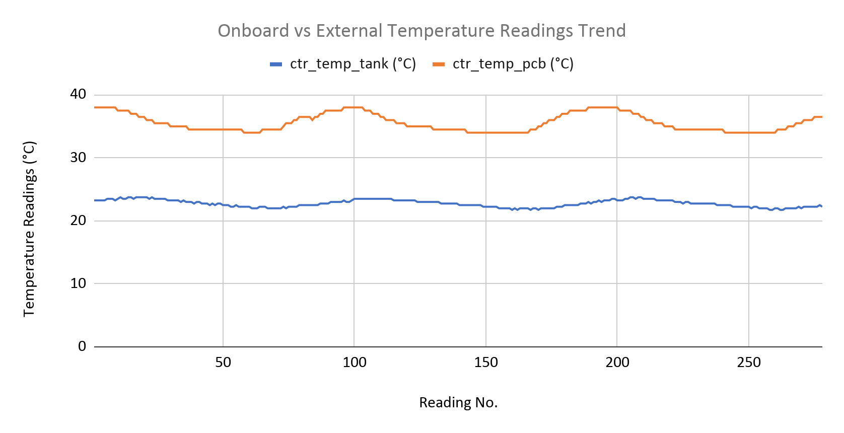
Results: Modified Firmware on Test KP (Cont’d)

Slide 26
Setup: Measuring Time Delay in Initializing Sensors
Test Parameters:
Introduced a delay of 5 seconds between every temperature reading
Measured time taken to do initial scan of the sensors
Introduced a repeat scan when a sensor is detected to be disconnected or when -127 is returned

Slide 27
Results: Measuring Time Delay in Initializing Sensors
Test Results:
Initial scan of the sensors takes 110ms when two devices are detected
Repeat scan of the sensors takes 40ms when one device is detected
Repeat scan continues in every temperature reading until 2nd sensor is detected
When sensor disconnects during a reading and returns -127 (Unknown), a repeat scan is done on the sensor that returned -127 before the next reading is taken

Slide 28
Signal Integrity of the Sensor
Ruled out as a root cause as the criteria for classifying the problem as being caused by a faulty signal is not met according to the firmware code

Slide 29
Conclusion
Modifying the KPC firmware to initialize the devices (sensors) connected to the board proved to be successful in mitigating the Temp State OU problem
Delay in initializing sensors is negligible
Recommendation
Apply the changes made during these tests to the current firmware code, to initialize the sensors initially and when the Temp State reads OU - Software to incorporate the changes in a future release

